Slide 1
Notes for the teachers
Dear colleagues,
Welcome to my content. This is my first content on right form of verb. Gradually I will make more contents on the same subject. You know that all the grammar items are now contextual. So I have designed this content contextually. If you find any short coming, recover it yourself. In case of any inquiry please call me in 01717220115.
Notes:
I like to request you to follow the instructions below the slides to conduct your class effectively.

Slide 2


.Welcome to the world of HHR Multimedia Presentation
Notes:
This the welcome slide.

Slide 3

Introduction
Md. Hasan Hafizur Rahman
Lecturer and Head of the department (English)
Cambrian School & College, Dhaka
Email: hasancambrian@gmail.com
Presentation made
for class VI-IX
Notes:
Introduction of class and presenter.

Slide 4
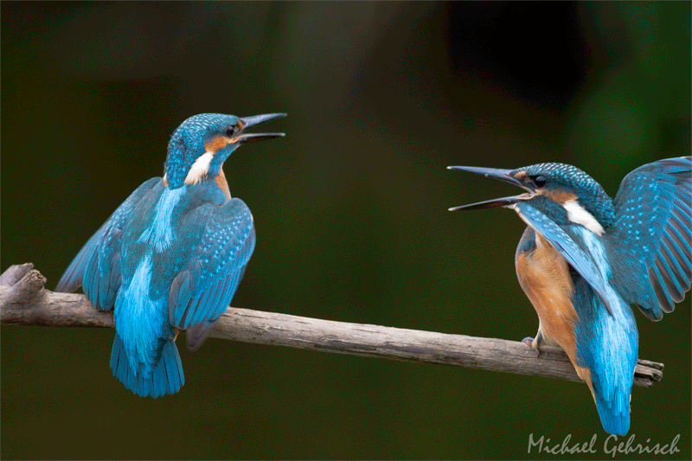
Two kingfishers is quarreling.
What is the wrong with the sentence?
Two kingfishers are quarreling.
Right form
Notes:
1st suspension to advance right form of verb.

Slide 5
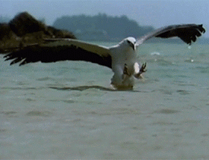
What is the right form of the verb?
The eagle is hunt the snake.
is hunting
Notes:
2nd suspension to advance right form of verb.

Slide 6
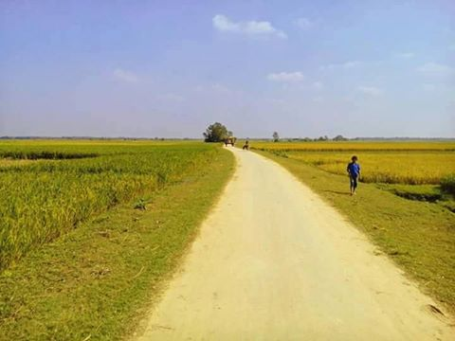
Our today’s lesson is-
Right form of verbs
Notes:
Lesson declation.

Slide 7
Learning outcomes
At the end of the lesson, students will be able to—
select verb for the gap
identify the position of ‘s/es’
identify the subject and verb agreement
apply the right form of the verbs
Notes:
The above outcomes will be focused in this content.

Slide 8
Note
At the time of filling in the blank with right form of
verb, a student is to perform two functions at a time.
1. Selecting appropriate verb for the gap
2. Writing the correct form of verb according to the context
To do the work easily, students should read the passage time and
again before filling the gap to select appropriate verb for each gap.
Notes:
Teachers are requested to make the students understand this slide clearly.

Slide 9

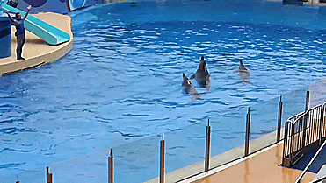
Find out appropriate verbs to fill in the blanks from the box and
apply their right forms according to the context.
enjoy | give | conduct | be | can
We (a) ________ see a dolphin show in the picture. A man (b)________the show.
Dolphins (c)________ very expert in playing games. It (d)________ us pleasure.
Everybody (e)_________ it very much.
Notes:
This passage is the example of a contextual question. Teacher may make the students understand about contextual question
with this example.

Slide 10
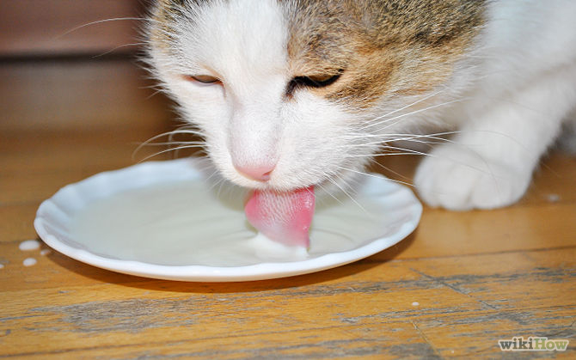
Focusing
1.
If the subject is third person singular number
in present tense, ‘s/es’ is added with the verb.
s/es
Third person singular number
Third person singular number
The cat likes milk.
The cat catches rats.
Notes:
The use of ‘s/es’ in present tense in third person singular number shown here.

Slide 11

Position of s/es
Do
+
es
Does
=
Push
+
es
Pushes
=
express
+
es
=
expresses
Catch
+
es
Catches
=
Note: If there is o,s, sh, ch at the last of the word, ‘es’ is to be added with
the verb in the present tense in case of subject 3rd person singular number.
‘s’ is used in another places.
Notes:
A big portion of the students do not know the position of ‘s/es’. This problem will be removed by this slide. Learning outcomes No-3 will be achieved from this slide.

Slide 12

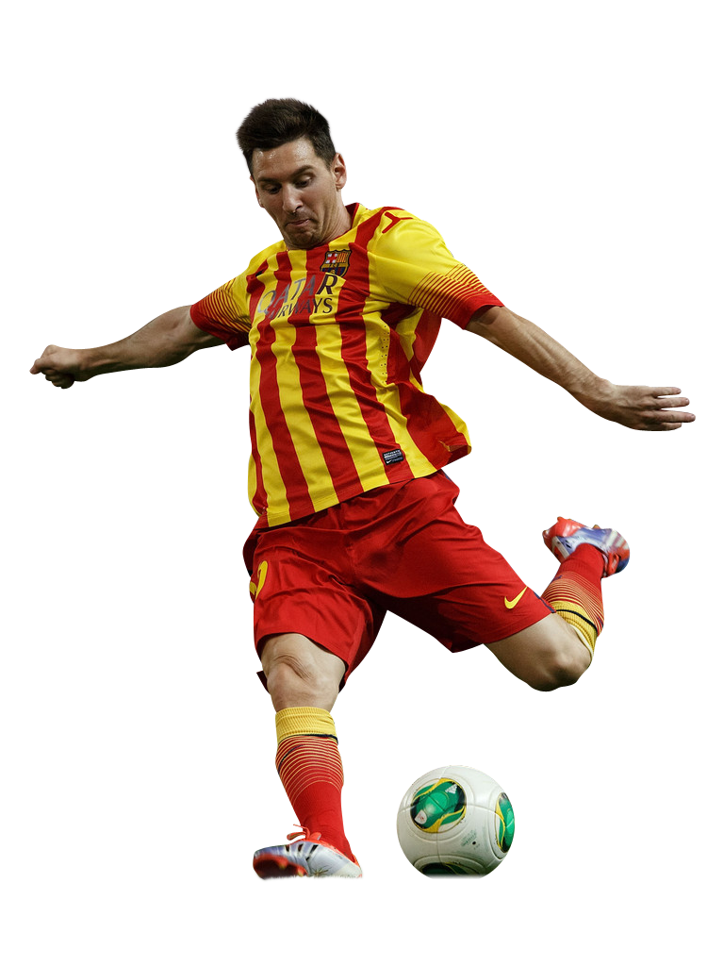
Activities
Fill in the blank with the right use of
s/es with the verbs in the box below.
pass | perform | go | push | like | teach
Messi is a world famous football player. He (a) _______ to the play ground regularly. Before going to the play ground he (b) _______ all related activities. He has a special technic to score goal. If one (c) _______ the ball to him, he (d) _______ the ball into the goal post with a very exciting technic. He (e) _______ his friends how to score goals. Everyone (f) _______ his technic very much.
Notes:
Evaluation through activities how much they achieve.

Slide 13
Let us see the subject and verb agreement
Subject | Verb to be in present tense | Verb to be in past tense | Verb to have in present tense | Verb to have in past tense
I | am | was | have | had
We | are | were | have | had
You | are | were | have | had
He | is | was | has | had
She | is | was | has | had
They | are | were | have | had
Rahim/The pen | is | was | has | had
Notes:
Teacher may teach this item as he likes.

Slide 14
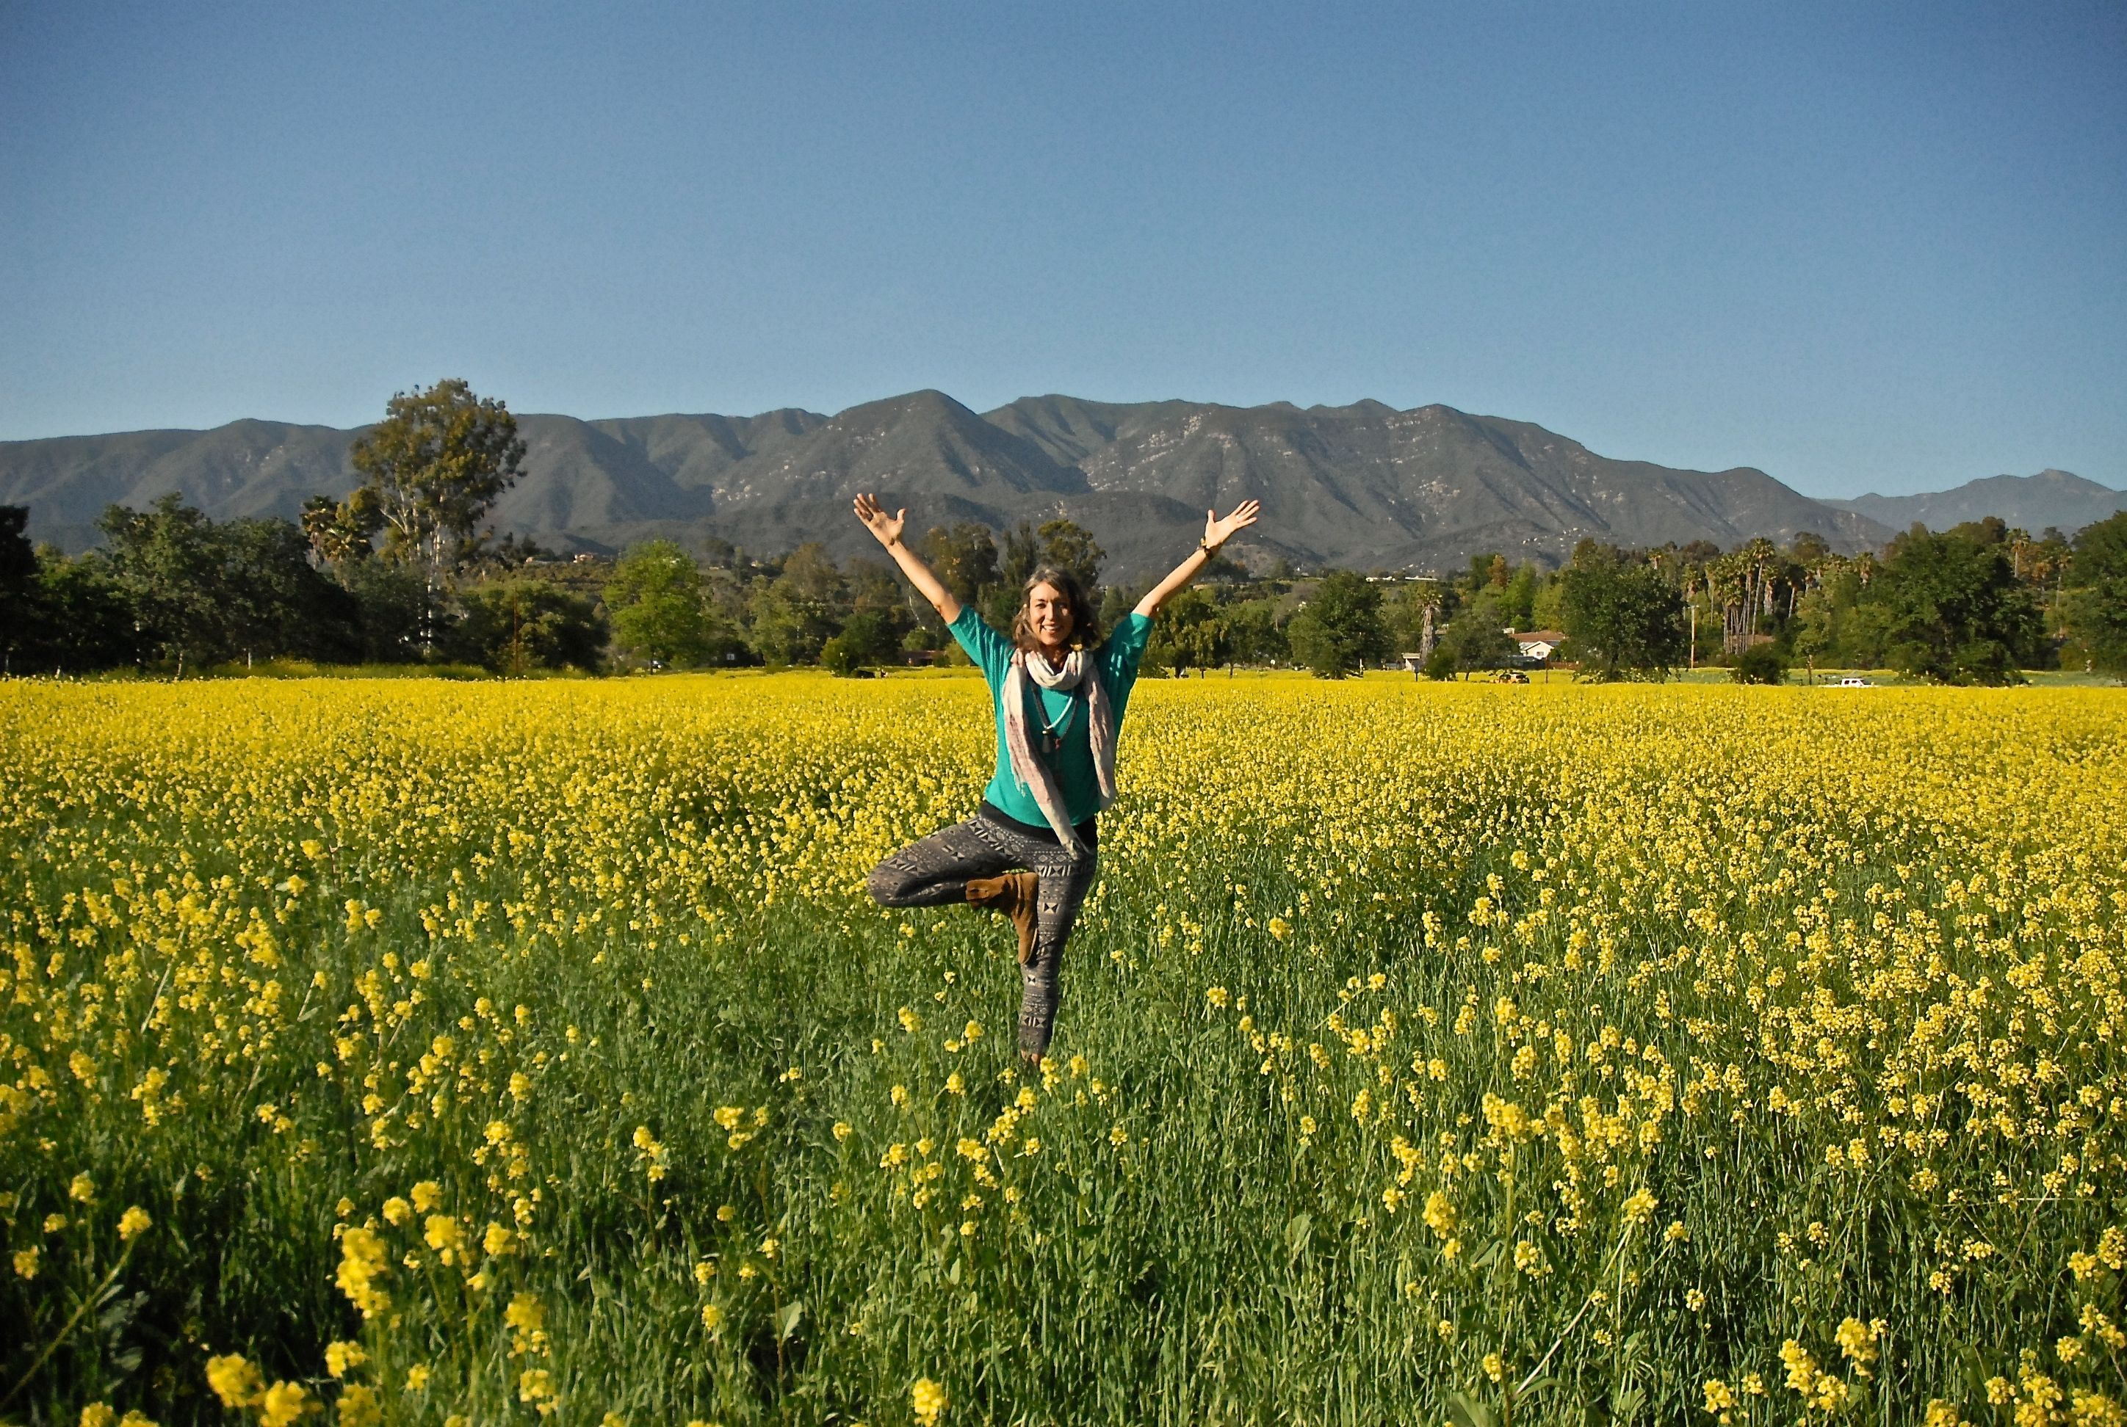
How beautiful the scenery is!
If the subject is singular, verb will also be singular.
Notes:
The position of singular verb according to singular subject shown here.

Slide 15
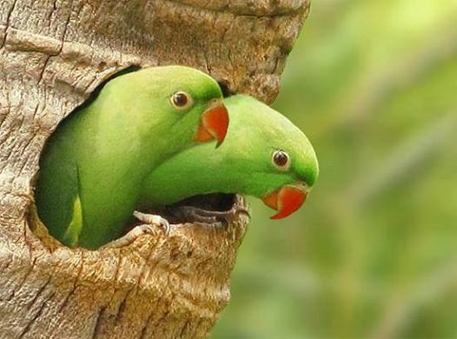
There are two parrots in the hole of the tree.
If the subject is plural, verb will also be plural.
Notes:
The position of plural verb according to plural subject shown here.

Slide 16
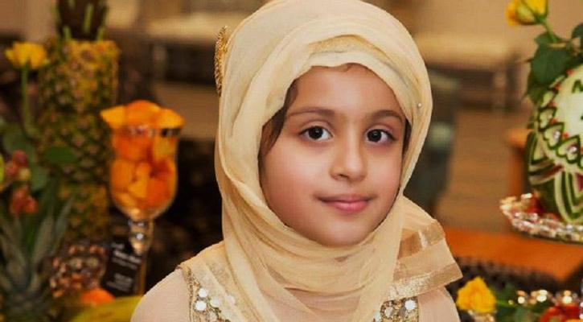
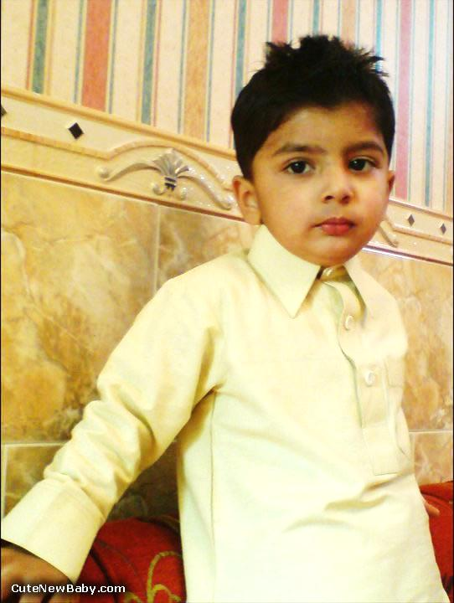
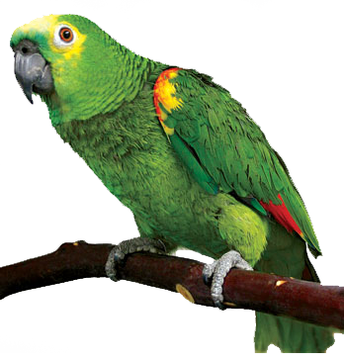
Fill in the blank with the verbs below according to subject and verb agreement.
am | was | is | are
were | have | had | have
I (a)______ Sujana. My father (b)_______a teacher and mother (c) _______ a housewife. They (d) _______ my best well wisher. They (e) _______ in London in 1995. We (f) _______ the sense of conducting a happy family. I (g) _______ a brother also. He (h) _______ a parrot. It (i) _______ bought from a man. I (j)______ a pussy cat but it is no more.
Notes:
Test of subject and verb agreement.

Slide 17

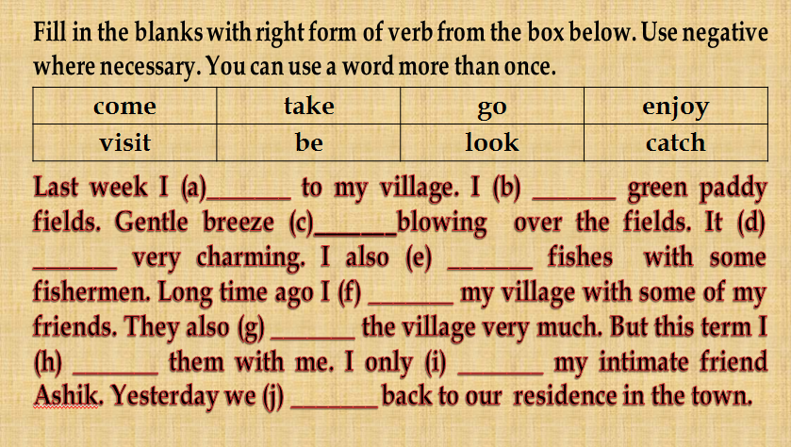
If last, yesterday, ago, long since or any past indicated
phrase is available in a sentence, the verb will be past.
Notes:
How, when and where past tense is used shown here. Students should read the passage again and again before solving the problems so that they can solve it easily.

Slide 18
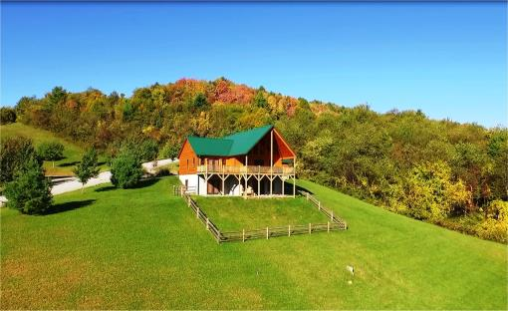
Home Work
Write a passage about yourself showing the right form of ten verbs like--
I am a student…………………………………..

Slide 19

Continue to content-2
Bye
Notes:
1st content on right form of verb ends here. It will be continued one after another.

Slide 20
Acknowledgement
We would like to express our cordial gratitude to the Ministry of Education, Directorate of Secondary & Higher Education, NCTB, A2i and the panel of honorable editors ( Md. Jahangir Hasan, Assistant Professor (English) TTC, Rangpur, Ranjit Poddar, Associate Professor (English) TTC, Dhaka, and Urmila Khaled, Assistant Professor (English) TTC, Dhaka, to enrich the contents.

